Slide 1
The impact of Treasury supply on financial sector lending and stability
Arvind Krishnamurthy
Annette Vissing-Jorgensenb

Slide 2
Table of Content
Key Argument
Key Assumption and Definitions
Model
Empirical Framework and Evidence

Slide 3
1. Key Argument
1. The amount of short-term debt issued by the financial sector is largely driven by nonfinancial sector’s demand for safe and liquid asset.
2. Government supply crowds out financial sector net short-term debt because financial sector short-term debt appeals to the same safety and liquidity demand as does government supplied assets.

Slide 4
2. Key Assumption and Definitions
Short-term bank debt and Treasury securities offer non-pecuniary services to households
Government Supply = Treasury supply-Foreign official Treasury holding
Treasury Supply = Treasury unbacked supply + Treasury metal-backed supply
Net short-term debt : the quantity of risky and illiquid assets funded by short-term debt
Notes:
First of all, the main reason why we are interested in this relationship between these two securities is the similarity between the two.
so that the yield on these assets are lower than that of loans.
Net: the amount of financial sector lending to the private sector financed by short-term debt →captures the demand element

Slide 5
2. Model
Government Bonds
Total supply of Ɵ
Households
Endowed by home and business capital
Own deposits and equity from financial sector
Own Government Bonds (r_{T})
Financial Sector
Issues Loans and Deposits
Owns Government Bonds (r_{T})

Slide 6
2.1 Government Bonds
$\frac{\text{Ɵ }}{1+rT}$ at T₀ Ɵ at T₁
Owned by Both Households and Financial Sector

Slide 7
2.2 Households
Three Capital Segments:
Endowment from Homes and Business: y₀ y₁ + K
Equity E from Financial Sector which pays out Dividends
Interactions with Financial Sector
Retain all or a fraction of Equity E
Take loans to back homes and business at r_{K}
Collateral of ƛ_{K}*K and receive $\frac{\text{ƛ}\text{K}\text{*}\text{K}}{1+\text{r}\text{K}}$
Investing by depositing at r_{D} or buying Treasury bonds at r_{T}

Slide 8
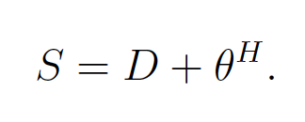
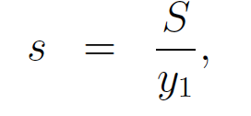
2.2 Households
Notes:
s : demand for short-term debt， D: deposit, 即short-term liabilities from the bank's perspective
v(s): function of bank deposits plus Treasury bonds to the date 1 income
v’(s): additional value that households place on short-term debt >0 → service such as providing liquidity
v’’(s) <0
So v(s) is a concave function 画图
Higher equilibrium value of s--> smaller v'(s) would be--> the spread tightens

Slide 9
2.3 Financial Sector
1. Constraint on Deposit Issuance
2. screening cost of choosing collateral rate
3.
Notes:
D: short-term liabilities
Deposit issued can not exceed collateral received and treasuries held
Along with screening cost，the goal is to maximize bank profit.
rT=rD by FOC for households→ both deposits and government bonds equally satisfy households’ debt demand.
Again FOC for the collateral rate or haircut implies that (22).

Slide 10
2.4 Impact of Changes in Ɵ
Net Short-term Debt of the Financial Sector
(bank lending funded by short-term debt)
Notes:
In a model with no special
debt demand, rK − rD = 0 and, hence, lamda K' = 0 (because 0(0) = 0) so lamda K=0. As
rK − rD rises, K rises. That is, banks respond to a higher spread between
loan rates and deposits rates by increasing lending financed by deposits.

Slide 11
2.5 Two Substitution Effects
1. Bank Portfolio Substitution Effect
D = ƛ_{K}*K + Ɵ^{F}
Fixed D; Increasing Ɵ^{F} as fully absorbing the fluctuations in Treasury supply
--> Reduced ƛ_{K}*K
2. Household Debt Substitution Effect
S = D + Ɵ^{H}
Regardless, net short-term debt of the financial sector ALWAYS falls with increases in Treasury Supply.
Notes:
First, consider the bank deposit constraint, D = KK + F . Consider an extreme case in which D is fixed and banks absorb the fluctuations in Treasury supply by changing F . Then, an increase in bank Treasury holdings must lead to a fall in KK and hence a fall in Net-ST. We refer to this as a bank portfolio substitution
effect.
Second, consider another extreme situation in which the increase in Treasury supply is fully absorbed by the households. In this case, households
decrease their demand for bank deposits at every interest rate, which leads
to a decrease in the equilibrium value of D. Banks then reduce lending, which is lambda K*K,
given that fewer bank deposits need backing. This is a household
debt substitution effect.

Slide 12
2.6 Extensions
1. Short-term vs. Long-term Treasury Bonds
An increase in Ɵ_{ST} has a larger crowding-out effect on Net-ST than an equal increase in LT.
2. Transaction Demand for Money
S = M+NTD + Ɵ^{H}
M: checkable deposits
NTD: non-transaction deposits
Notes:
Variations of the model:
suppose that there are two classes of Treasury bonds that differ in the attributes they offer households and banks. Short-term government bonds are assumed to be perfect substitutes for deposits, both satisfy the safety and liquidity demand of households. Another collateral term is assigned to LT debts. And apply the basic model, the result is that.....
Another variation is on transaction demand for money, which basically represents non-interest bearing deposits at banks. As a result, the FOC for the bank in choosing lamda K is exactly the same as before.

Slide 13
3.1 Empirical Evidence Ɵ
Notes:
Government Supply = Treasury supply-Foreign official Treasury holding
Treasury Supply = Treasury unbacked supply + Treasury metal-backed supply

Slide 14
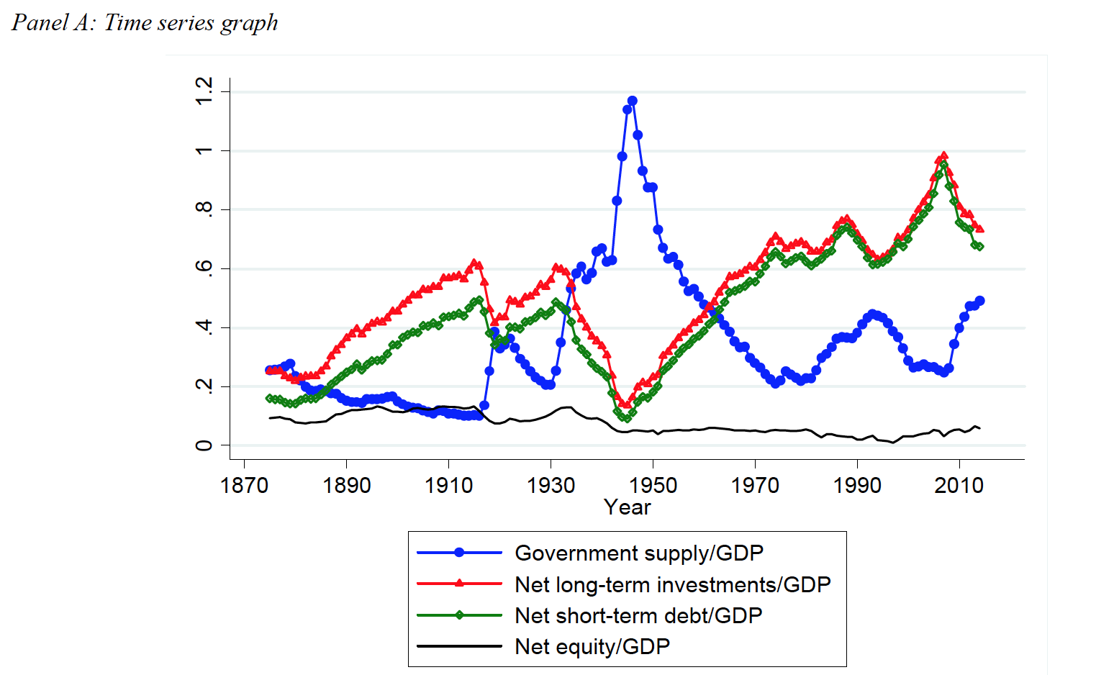
3.1 Empirical Evidence the US Financial Sector
Excludes the Fed (Non-private), long-term debt issuers (insurance companies, funds, GSEs, etc.)
Notes:
Because balance sheet sheet containing net long-term investments, net
short-term debt, and net equity has to balance, net long-term investments equal the sum of net short-term debt and net equity.
Therefore, net short-term debt is the part of net long-term investments financed with short-term debt, and net equity is the part of net long-term
investments financed with equity.

Slide 15
4. Results
Notes:
The scatter plot provides visual evidence consistent with our model of
financial crowding out. A strong negative relation exists between Net short-
term debt/GDP and Government supply/GDP, and it seems to be consistently present over the full 140-year period.

Slide 16
4.1 Results

Slide 17
4.2 Results Standard Crowding Out? --No!
1946-2014: Negative correlation between Government supply and real short rate
Including real/nominal interest rates in the model has very little effect on the coefficient between GDP-scaled Government supply and net short-term debt
Notes:
Is there any alternative reasons that cause this relation?
Standard crowding out is when gov’t borrows a lot of money. So the growing demand of borrowing pushes real interest rate higher, and gov’t bonds absorb economy’s lending capacity. As a result, accumulation of new capital in private sector is crowded out.
The key relation in classic standard crowding out is rising interest rate against grow in government supply.

Slide 18
4.2 2) Control of Short Rate
Notes:
Including real/nominal interest rates in the model has very little effect on the coefficient between GDP-scaled Government supply and net short-term debt

Slide 19
4.2 Results Standard Crowding Out? --No!
1946-2014: Negative correlation between Government supply and real short rate
Including real/nominal interest rates in the model has very little effect on the coefficient between GDP-scaled Government supply and net short-term debt
Crowing-out effect from this model is robust to controlling for the size of the private capital stock / GDP
Notes:
Thirdly, they want to test if private capital stock has any significant role.
Private capital stock: sum of private fixed assets and consumer durable goods at current prices

Slide 20
4.2 3) Control of Private Capital Stock
Notes:
In Column 2 and 3, Net short-term debt/GDP is decomposed into Net short-term debt/Private capital stock and Private capital stock/GDP.
The regressions show that Government supply/GDP is negatively related to both of these variables, with the statistically strongest effect on Net short-
term debt/Private capital stock.
Thus, crowing-out effect from this model is robust to controlling for the size of the private capital stock / GDP

Slide 21
4.2 Business Cycles?
Notes:
An obvious variable that could drive both government supply and net short-term debt is recent economic growth. The result is that including the growth
control has almost no effect on the size and significance of the crowding-out coefficient. The reason is likely that government supply moves at a slower
frequency than the business cycle.
As shown the Government supply/GDP series (and the series for Net short-term debt/GDP) changes
slope only about ten times over the 140-year sample. For comparison, there are 28 business cycle peaks and 29 business cycle troughs over this period. This implies that the main finding is unlikely to be driven by any omitted variable that moves at a business cycle frequency
They actually did experiments with variables related to the business cycle trough dates, finding none that affects the crowding-out results substantially.

Slide 22
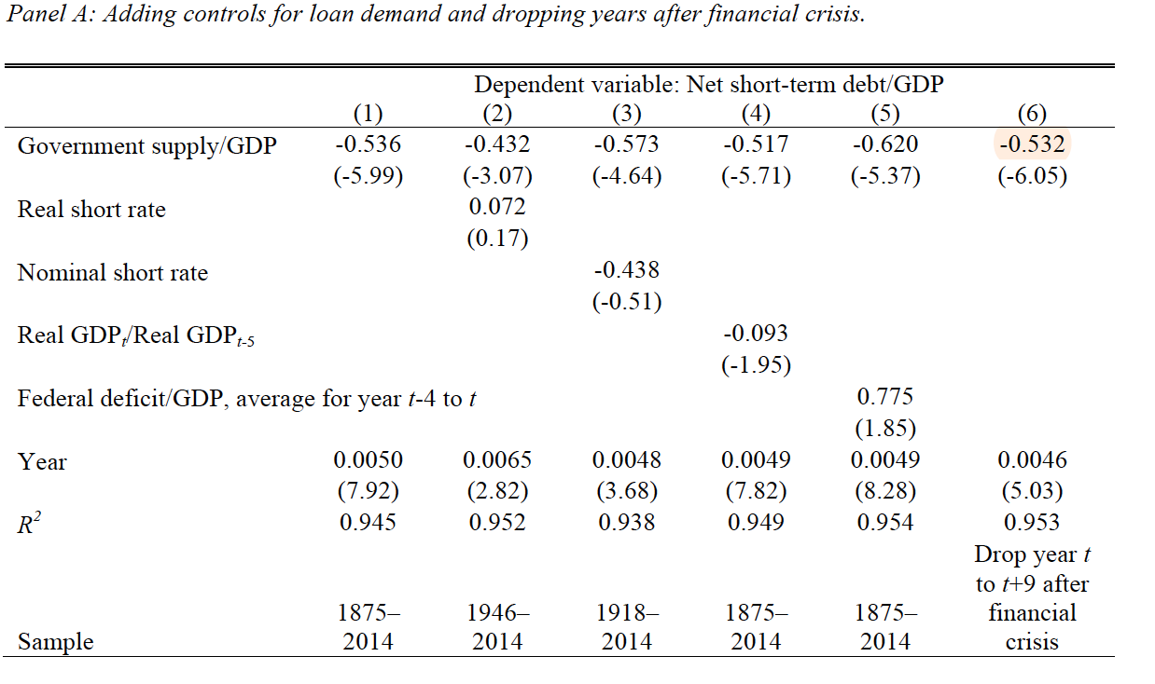
4.2 08 Financial Crisis?
Notes:
2008: Government funded a lot of cash to purchase treasuries and mortgage-backed securities and agency debts.
Column 6 drops years in which reverse causality is likely, namely, years following a financial crisis when the financial sector contracts and the associated recession causes an increase in government supply. Again, this has little impact on the coefficient of government supply/GDP.

Slide 23
4.3 Further Evidence 1) 1933-1940: Gold Inflows
Notes:
There is a dramatic increase in gold certificates (which are part of Treasury metal-backed supply) during the 1933 to 1940 period.
During this period, net short-term debt falls significantly despite this being the period of recovery from the Great Depression. Importantly, Treasury
unbacked supply, as a ratio to GDP, is virtually unchanged during this period.
Theory predicts that the gold inflows will have two effects on bank debt. [S=D+theta] First, the increase
in government supply will crowd out bank debt in the same manner as other changes in Treasury supply. Second, to the extent that foreigners who bring
in gold hold their assets as bank deposits, the crowd-out will be reduced.
Interestingly, in the 1933–1940 period, the size of the financial sector relative to GDP declines somewhat from 0.685 in 1933 to 0.646 in 1940, suggesting that foreigners did not use the majority of their inflows for bank deposits. And this is puzzle missing from the graph.

Slide 24
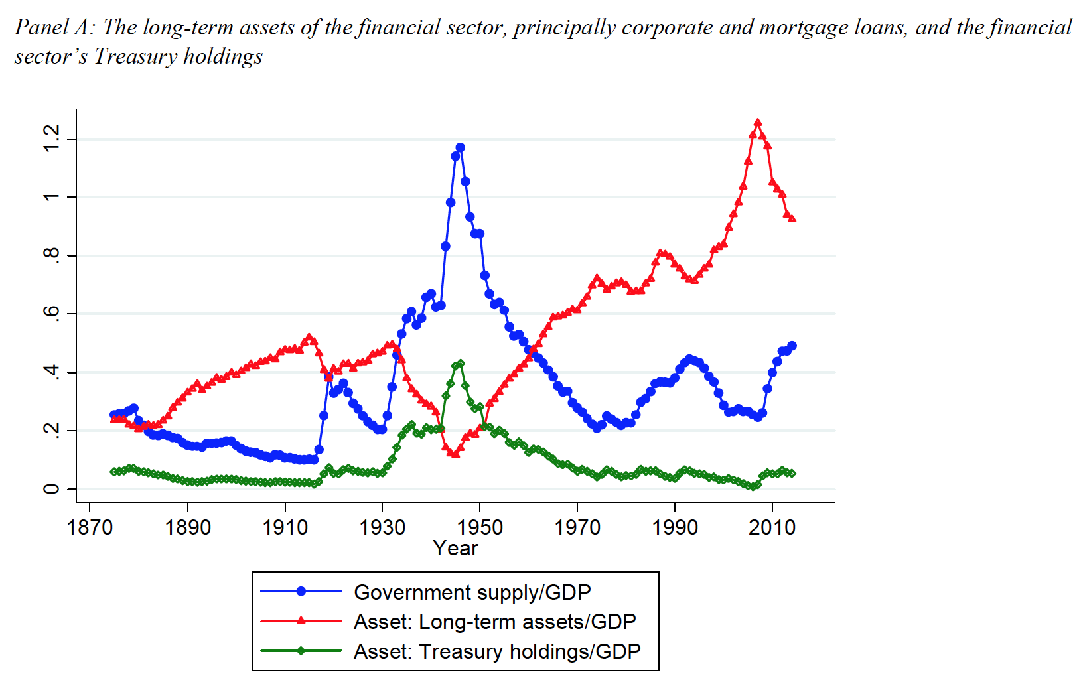
4.3 Further Evidence 2) Bank Substitution Effect
D = ƛ_{K}*K + Ɵ^{F}

Slide 25
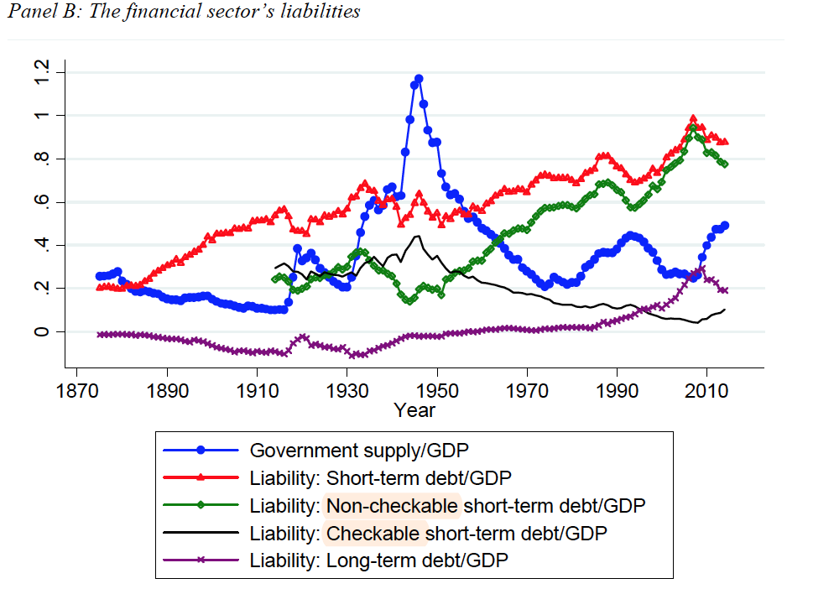
4.3 Further Evidence 3) Household Substitution Effect
S = D+ Ɵ^{H}
Notes:
Demand for Bank deposits decreases
The liability side, such household debt substitution appears to be present for non-checkable short-term debt, but with an almost off-setting crowding-in effect for checkable deposits. Treasuries could be particularly important for backing checking deposits, more so than non-checkable deposits, so that the crowding-in of
checking is a reflection of the bank portfolio substitution effect. Short-term debt/GDP overall, combining checkable deposits and non-checkable short-term debt, is only weakly crowded out by government supply, with an in significant coefficient of -0.061 for the full 1875 to 2014 sample.

Slide 26
Conclusion
Interesting timing for us to think about effects from Treasury supply
Possible follow-up research on extensions
Research mechanisms are solid
Adopt bootstrap-after-bootstrap standard errors for more accuracy
Control of multiple potential alternatives
Identify key factors

